Slide 1
Robert Anda, MD
Vincent Felitti, MD

Slide 2
The ACE Study: The Effect of Adverse Childhood Experiences on Adult Health and Behavior
Arlene Nock, M.D.
Assistant Professor Albany Medical College
Staff Psychiatrist Stratton VA Medical Center
Albany, NY

Slide 3
History of the Adverse Childhood Experiences Study
Vincent Felitti, an endocrinologist, ran a successful weight loss clinic at Kaiser Permanente in San Diego, CA
Many of his most successful patients dropped out of the study or gained their weight back
He interviewed them and found a high percentage of these patients had abuse, household dysfunction or neglect during childhood
In 1991, he presented his findings at the CDC, and Robert Anda was very interested

Slide 4
History, continued
Together, they set up the largest study ever done to examine the link between adverse childhoods and health over the course of a lifetime.
It was a retrospective and a prospective study of 17,421 patients who presented for their annual health exam and agreed to fill out a long questionnaire about their childhood to age 18.
Average age was 57. 80% white, 10% AA, 10% Asian. 51% F, 49% M. 74% some college, 46% graduated college

Slide 5
The Relationship of Adverse Childhood
Experiences to Adult Health Status
A collaborative effort of Kaiser Permanente and The Centers for Disease Control
Vincent J. Felitti, M.D.
Robert F. Anda, M.D.
Notes:
1

Slide 6
Overview of Findings
Adverse Childhood Experiences (ACEs) are very common – over 50% of people have at lease one ACE
ACEs are uncommonly recognized
Concealed by time, shame, secrecy, social taboos
ACEs are the strongest predictor of adult disease risk factors, disease and early mortality
Public health problems are actually solutions/coping strategies for people with unrecognized early adversity that no one talks about.

Slide 7
Categories of Adverse Childhood Experiences
Abuse: Women Men Total
Sexual (by anyone) 24.7% 16.0% 20.7%
Physical (by parent) 27.0% 29.9% 28.0%
Emotional (by parent) 13.1% 7.6% 10.6%
Neglect:
Emotional 16.7% 12.4% 14.8%
Physical 9.2% 10.7% 9.9%

Slide 8
Categories of Adverse Childhood Experiences (2)
Household Dysfunction: Women Men Total
Substance abuse 29.5% 23.8% 26.9%
Mental illness 23.3% 14.8% 19.4%
Mother treated violently 13.7% 11.5% 12.7%
Parental loss (death/div) 24.5% 21.8% 23.3%
Imprisonment 5.2% 4.1% 4.7%

Slide 9
ACE Study slides are from:
Robert F. Anda MD at the Center for Disease Control and Prevention (CDC)
September 2003 Presentation by Vincent Felitti MD “Snowbird Conference” of the Child Trauma Treatment Network of the Intermountain West
“The Relationship of Adverse Childhood Experiences to Adult Medical Disease, Psychiatric Disorders, and Sexual Behavior: Implications for Healthcare” Book Chapter for “The Hidden Epidemic: The Impact of Early Life Trauma on Health and Disease” Lanius & Vermetten, Ed)

Slide 10
Adverse Childhood Experiences vs. Current Smoking
%
Notes:
This slide is a bar chart representing adverse childhood experiences versus current smoking.
ACE Score Percentage
0 5.5
1 6
2 8
3 10
4 to 5 12
6 or more 16

Slide 11
Childhood Experiences vs. Adult Alcoholism
4+
3
2
1
0
Notes:
This slide is a bar chart titled child experiences versus adult alcoholism.
ACE score Percent alcoholic
0 2.8
1 5.7
2 10.3
3 11.4
4 or more 16.1

Slide 12
ACE Score vs. Intravenous Drug Use
N = 8,022 p<0.001
Notes:
This slide is a bar graph titled ACE score versus intravenous drug use. It presents ACE scores and the percent of people who had injected drugs. The population size is 8,022 and the confidence level is less than .001.
ACE Score Percent that have injected drugs
0 .3
1 .5
2 1.4
3 2.3
4 or more 3.4

Slide 13
Adverse Childhood Experiences vs. Likelihood of > 50 Sexual Partners
Notes:
This slide is a bar graph titled adverse childhood experiences versus likelihood of more than 50 sexual partners.
ACE Score Adjusted Odds Ratio
0 1
1 1.7
2 2.3
3 3.1
4 or more 3.2

Slide 14
Adverse Childhood Experiences vs. History of STD
Notes:
This slide contains a bar graph titled adverse childhood experiences versus history of STD (sexually transmitted disease).
ACE Score Adjusted Odds Ratio
0 1
1 1.45
2 1.5
3 1.9
4 or more 2.5

Slide 15
ACE Score vs. Smoking and COPD
Notes:
This slide has a bar graph titled ACE score versus smoking and COPD (chronic obstructive pulmonary disease).
ACE Score Regular smoking by age 14 COPD
(percent with problem) (percent with problem)
0 3.9 6.9
1 4.2 8.2
2 7.1 11.1
3 7.8 15.5
4 or more 12.3 17.5

Slide 16
Childhood Experiences Underlie Chronic Depression
Notes:
This slide contains a bar graph titled childhood experiences underlie chronic depression with statistics on the percentage of women and men with a lifetime history of depression.
ACE Score Percentage of Women Percentage of Men
0 18 11
1 24 19
2 35 25
3 42 30
Greater than or equal to 4 58 35

Slide 17
Childhood Experiences Underlie Suicide
4+
3
2
1
0
Notes:
This slide contains a bar graph titled childhood experiences underlie suicide and presents ACE scores and the percentage of people attempting suicide.
ACE Score Percent attempting suicide
0 1.4
1 2.6
2 4.8
3 10.7
4 or more 19.3

Slide 18
Childhood Experiences Underlie Rape
4+
3
2
1
0
Notes:
This slide is a bar chart titled childhood experiences underlie rape and presents the ACE scores and percentage of people reporting rape.
ACE Score Percent reporting rape
0 4.7
1 10.2
2 16.5
3 18.4
4 or more 32.1

Slide 19
ACE Score and Hallucinations
Abused
Alcohol
or Drugs
Ever Hallucinated* (%)
ACE Score
*Adjusted for age, sex, race, and education.
Notes:
This slide is a bar graph titled ACE score and hallucinations. It presents the ACE scores of people who had abused alcohol or drugs and people who had not and the percent of each who had ever hallucinated. (Adjusted for age, sex, race, and education.)
ACE Score Percentage of not ever hallucinated Percentage of ever hallucinated
0 1.2 2.7
1 1.2 2.8
2 2 3.1
3 2.1 4.3
4 1.1 4.8
5 1.9 6.1
6 3.4 7.1
Greater than or equal to 7 8.9 10.1

Slide 20
ACE Score vs. Serious Job Problems
Notes:
This slide is a bar graph titled ACE score versus serious job problems.
ACE Score Percent with Job Problems
0 7.5
1 10.4
2 14.4
3 16.7
4 or more 17.8

Slide 21
Top 10 Risk Factors for Chronic Illness and Death in Adults
Smoking
Severe obesity
Depression
Suicide attempts
Alcoholism
Inactivity
Illicit drug use
IV drug use
Having 50+ sexual partners
History of sexually transmitted disease

Slide 22
Adverse Childhood Experiences are the Biggest Risk Factor for these Behaviors
If you have an ACE of zero, you are likely to have few, if any, risk factors.
If you have an ACE of 4 or more, you are likely to have many of these risks factors for disease, or the disease itself.
ACEs are the most basic cause of health risk behaviors, morbidity, disability, mortality and health care costs

Slide 23
A Tour through the Neurophysiological Foundations of the Long Term Effects of ACEs
Arlene Nock, MD
Psychiatrist at Stratton VAMC
Assistant Professor, Albany Medical College

Slide 24
Odds Adjusted Ratios for Risk Behaviors
ACE Score | 0 | 1 | 2 | 3 | 4 | 5+
Alcoholism/IV drug use | 1.0 | 1.9/1.0 | 2.1/2.5 | 2.7/3.5 | 4.5/3.8 | 5.1/9.2
Attempted suicide | 1.0 | 1.8 | 4.0 | 4.0 | 7.2 | 16.8
Domestic violence | 1.0 | 1.9 | 2.1 | 2.7 | 4.5 | 5.1
Being raped | 1.0 | 2.0 | 2.8 | 4.2 | 5.3 | 8.9
3+ marriages | 1.0 | 1.5 | 1.6 | 2.1 | 2.9 | 3.8
Mult. sex partners | 1.0 | 1.6 | 1.9 | 3.4 | 4.4 | 5.8
Unwanted preg -nancy/abortion | 1.0 | 1.5 | 1.9 | 2.3 | 2.1 | 2.9

Slide 25
The higher the ACE Score, the more significant risk for chronic health conditions:
Depression
Anxiety
Liver disease
COPD
Ischemic heart disease
Autoimmune disease
Lung cancer
Notes:
The more adverse and traumatizing events experienced in childhood, - higher the ACE Score, - the more likely an individual will develop serious health conditions later in life.
The ACE Study found Consistently graded relationships between higher ACE scores and the development of serious health conditions later in life, including Sexually Transmitted Disease; Liver Disease; COPD; Ischemic Heart Disease; Autoimmune Disease; and Lung Cancer.
ACE data offers compelling evidence that behaviors known to increase the risk of chronic diseases have had their origins in childhood regardless of the changing influences of the 20th century.
In heart disease – the study found a strong relationship of ACE score to coronary disease, after correcting for all the conventional risk factors like smoking, cholesterol, etc. Which illustrates how ACEs in childhood are related to adult disease by two basic etiologic mechanisms:
Conventional risk factors – attempts at self help through use of agents like nicotine, drugs, alcohol, AND,
2) the effects of chronic stress on the developing brain and body systems.
This information challenges the disciplines of medicine and public health to address both the primary prevention and secondary prevention of ACEs in the 21st century.

Slide 26
The ACE Score is the Sum of the Categories
ACE Score Prevalence Court
0 48% 0%
1 25% 10%
2 13% 22%
3 7% 33%
4 or more 7% 35%
Court data from Vivian Brown, PhD, 2014

Slide 27
Adults in Court System
70% of women who were in foster care as children have an ACE score of 5 or more.
23% of women who were in foster care as children have an ACE score of 9.
48.3% of male offenders in criminal court had an ACE of 4 or more, as compared to the general population where 12.5% reported 4 or more.
Data from Vivian Brown, PhD from the Colorado Convening Conference, April 2014

Slide 28
Male Offenders in Criminal Courts ACE categories General Population Male Offenders
Emotional Abuse | 7.6 | 52.3
Physical Abuse | 29.9 | 41.1
Sexual Abuse | 16.0 | 27.2
Emotional Neglect | 12.4 | 50.3
Physical Neglect | 10.7 | 21.9
Household Substance Use | 23.8 | 47.7
Household Mental Illness | 14.8 | 25.8
Violence Towards Mother | 11.5 | 27.8
Household Member in Prison | 4.1 | 20.5
Loss of Parent | 21.8 | 53.6

Slide 29
So, we made it through everything, we’re 18, we can leave the abuse and dysfunction….

Slide 30
Why don’t we just sigh with relief at being out of the terrible environment of childhood?

Slide 31
Places to find clues
Infant brain development
Types of memory
Epigenetics
Stress response: healthy and chronic
The reward system
Hints from sleep physiology
Polyvagal Theory developed by Dr. Porges

Slide 33
The Newborn!
All 100 billion neurons are already there
DNA: the script is in place
The environment will determine how we read that script
We will grow the brain we need for the environment we are in
That growth takes place in the context of a nurturing interpersonal relationship

Slide 34
Parental Interactions in Infancy
How the brain learns about the environment
How the brain develops neurologically during the first 2 years
How the brain learns to make transitions
How the brain learns to soothe, play, self regulate
We grow the brain we need for the environment we find ourselves in

Slide 35
How
do you hold a
baby?

Slide 36
Right brain to right brain
Alex Gray
“Sacred Mirrors”

Slide 37
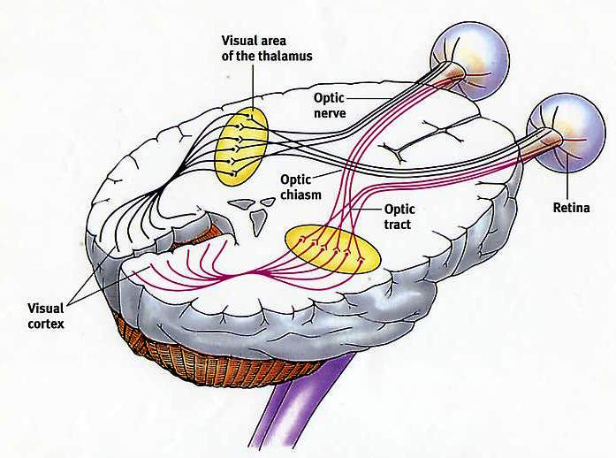

Slide 38
The Relationship is Interactive
The parent figure attunes to the infant and helps the infant maintain a sense of safety
The parent figure soothes the infant when the infant is experiencing negative emotions or is transitioning from one state to another
The parent figure expands the emotional repertoire through play
The parent figure instills a sense of safety during sleep, eating, defecating

Slide 39
The parent and child are one unit
The infant senses distress
It puts out a signal
The signal changes something in the receiver
The receiver behaves in a way that is consistent with the signal of the infant
The infant is soothed
Each part is separate but linked, and each is changed by the other.
This is secure attachment

Slide 40
Newborns can differentiate between mother’s voice and another female voice

Slide 41
Early Brain Development
No awareness of “other”
Right hemisphere develops during the first 18 months of life before the left hemisphere comes “on-line”
It develops a non-verbal understanding of the environment
It cannot develop without interaction with another person: Attachment
The right parietal lobe develops a sense of “self”

Slide 42
Cycles of hemispheric development
Right brain is dominant for first 2 years, then the left becomes dominant

Slide 43
Right Parietal Lobe
Emotional memory
Implicit memory
Sense of self
Attachment relationships are the basis of the brain’s self-regulatory mechanism

Slide 44
Importance of Right Parietal Lobe
Where we feel grounded
Sense of comfort: “I think I can make it through this”
Skill area – how we do things, including how to make connections to someone else, how to interact with the world
Has no sense of time – everything is in the present tense

Slide 45
Other types of attachment
Ambivalent-insecure attachment
Parent responds but without an understanding of the infant’s need
There’s a connection, but not a good sense of self
Avoidant-insecure attachment
Parent does not respond to signals
Separate from the parent, but no ability to soothe itself
Disorganized attachment
Parent is also a source of fear, pain,
No connection, no pleasure, no soothing

Slide 46
Consequences of Inadequate Attachment
Impaired self-awareness
Poor affect regulation
No coherent, continuous or unified sense of self
Difficulty with empathy
Hard to feel pleasure
Difficulty with play

Slide 47
The Empty, Painful Heart: the legacy of inadequate attachment

Slide 48
The Right Hemisphere

Slide 49
Implicit Memory
Memory of the right hemisphere
Only type of memory during our first 2 years of life
No time stamp placed on implicit memories because the hippocampus is not involved
Involves perceptions, emotions, behaviors, bodily sensations
Repeated experiences are organized into schema that can be triggered to prepare us for the future

Slide 50
Implicit Memory
Uses past experiences to remember things without thinking about them
Unconscious memory: This is the only type of memory we have before the left hemisphere is online.
Procedural memory: muscle memory for movements to master a physical routine
The basis for habits, opinions, choices

Slide 51
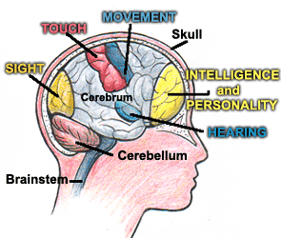
Right Frontal Lobe
Information from the right parietal lobe about the environment comes to the right frontal lobe where “rules” are made about our world
It tries to keep things consistent and chooses data to make the rules fit so it can understand the environment

Slide 52
Our brain organizes sensory input to understand our environment
Light waves enter the eyes and hit the retina
Sound waves enter the ears and move the tympanic membrane
Touch sensors register pressure
Temperature and pain receptors
Taste and smell receptors
Internal sensations from the body

Slide 53
Every species processes sensory input differently and is able to process different wavelengths of light, sound, heat

Slide 54
Daniel Kish

Slide 55
Hollow?
Bulging?

Slide 56
Vertical or Horizontal Rows?

Slide 57
How About Now?

Slide 58
Explicit Memory
A function of the left hemisphere
Episodic Memory: memory of events that are personal like a birthday party, where you lived as a child
Semantic Memory: general knowledge of the world learned through repeated exposure to information which is no longer connected to context
Hippocampus is necessary for explicit memory

Slide 59
Hippocampus: Date, Time and Context

Slide 60
Response to Environment has Two Pathways: Long and Short

Slide 61
Hippocampus
Necessary for the laying down of explicit memory
Is not developed until about 2 years of age
Involved in memory integration by assembling pieces of implicit memory into framed pictures of episodic memory with sense of self and time
These pictures become integrated into autobiographical memory
This may occur during rapid eye movement

Slide 62
Sleep Physiology
Awake: Brain is bathed in serotonin and norepinephrine
Stage I – III: The “REM off” cells start firing more slowly; serotonin and norepinephrine slowly drain away
Stage IV: The “REM off” cells stop firing and release the inhibition of the “REM on” cells
REM sleep: Acetylcholine released. Paralyzed at the brain stem; no sensory input, no motor output

Slide 63
Our assumptions about our environment are based on sensory input from the present that is interpreted through the emotional memory of our past experience.

Slide 64
So why do we all perceive the same physical sensory input differently?
Epigenetic changes
Early attachment patterns establish the ability of the brain to integrate experience from both hemispheres
Long term memory is laid down differently in the right and left hemispheres and depends on environment
Sensory input in the present is processed through memory of past experience
Perceived level of safety or threat depends on the past and determines how we respond

Slide 65
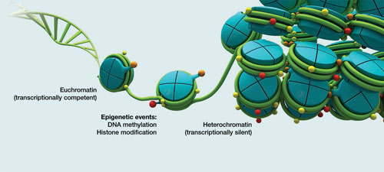
Epigenetics

Slide 66
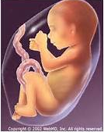
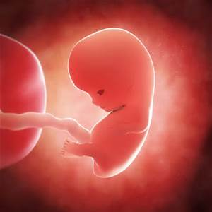
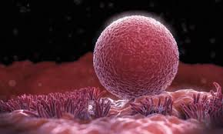
3rd trimester fetus
1st trimester fetus
Human ovum

Slide 67
Dutch Hunger Winter November 1944-May 1945
Women who were in their last trimester had low birth weight babies
They stayed small their entire lives with lower obesity rates
Women who were in their first trimester had normal weight babies
They had higher obesity rates than general population
Higher incidence of other physical and mental health problems
The grandchildren of these women showed these effects as well

Slide 68
What is Epigenetics?
Every cell in our body has the same genetic information, yet each cell type is unique.
The DNA (genome) in Chimpanzees and humans is 99% identical. Almost all species, including sponges, share at least 50% of the same genome.
Epigenetics is study of how so many diverse cells and species can arise from the same essential genome.
Like how everything ever written in the English language has come out of the same 26 letters.l

Slide 69
Epigenetics is like Punctuation
A woman without her man is nothing

Slide 70
We can mean:
A woman, without her man, is nothing.

Slide 71
Or:
A woman: without her, man is nothing.

Slide 72
Epigenetic Changes can be Life-threatening!
Let’s eat Spot!
vs
Let’s eat, Spot!

Slide 73
Expression of our Genes is Determined by the Environment
Molecular changes in the DNA that determine what genes are turned on or off.
The genes are not altered.
The expression of genes is altered.
If these molecular changes occur at a critical time, they persist through life.
These changes can be passed into the next and future generations

Slide 74
Telomeres

Slide 75
Examples of Environmental Effects on Telomeres
Abused children at age 5 have shortened telomeres. If the abuse continues, there is progressive shortening at age 10
Institutionalized infants and children have shortened telomeres
In girls the strongest predictor is the extent of deprivation
In boys the strongest predictor is the cumulative exposure
The greater the percent below the poverty level, the shorter the telomere length
The mother’s perception of their environment as dangerous – their children had shortened telomeres

Slide 76
Environment Alters our Epigenome
Neonatal environment
Early environment
Paternal epigenetic markers are wiped out during the first trimester of pregnancy
Many epigenetics markers are set down in the egg during fetal development
Passed down from grandmother to mother to child

Slide 77
Continued…
Oxidative stress – free radicals – can cause shortened telomeres.
Diets deficient in fruits and vegetables
Diets high in trans fats (hydrogenated)
Diets high in highly processed foods
Caregivers of children with chronic illness have shortened telomeres

Slide 78
Brain-Derived Neurotropic Factor
A protein secreted in the central and peripheral nervous system
Supports nerve cells and encourages growth
Especially active in the hippocampus, cerebral cortex and basal forebrain – learning, memory and higher thought processes
BDNF is involved in depression, anxiety, Alzheimer’s, OCD, anorexia, bulimia, eczema, epilepsy, addiction

Slide 79
Studies in Rats
Total maternal deprivation resulted in a shut-down of brain-derived neurotropic factor (BDNF) in the pups (via methylation)
Methylation levels were higher than in both controls and in chronically stressed pups
Hippocampus is smaller in depression and PTSD
SSRIs work by stimulating BDNF and stimulating neurogenesis in the hippocampus
Don’t work if this cannot happen as in pups with maternal deprivation

Slide 80
HPA Axis: Healthy Stress Response

Slide 82
Body’s Healthy Steps to Respond to Stress
Aware of change in the environment: release norepinephrine – works very quickly
Sensory information gets sent to the amygdala: are we afraid of this?
If so, message gets sent to the hypothalamus: release corticotrophin releasing hormone (CRH)!
CRH stimulates pituitary to release adrenocorticotropic hormone (ACTH)…
ACTH stimulates the adrenal gland to produce cortisol
Cortisol then turns off the CRH.

Slide 84
Chronic Cortisol Release

Slide 85
Chronic Cortisol Release

Slide 86
Hippocampus during stress
During times of extreme stress when there are high levels of cortisol the hippocampus shuts down – this is an epigenetic change
When attention is divided, the hippocampus only lays down explicit memory for the experience that is the focus of attention
Those experiences then become exclusively implicit memories that are free floating sensations with no time stamp

Slide 87
The Reward System

Slide 88
Nucleus Accumbens
Pleasure center: Humans and rats will stimulate this area repeatedly to the exclusion of everything else.
Repeated overstimulation numbs the response of these neurons through a process of a negative feedback loop.
Cells produce a molecule called CREB (cAMP response-element binding protein) which causes the release of dynorphin that inhibits the stimulation of the nucleus accumbens
It becomes less sensitive to all types of stimulation, so everyday pleasures aren’t felt. Only the drug gets through to stimulate pleasure.

Slide 89
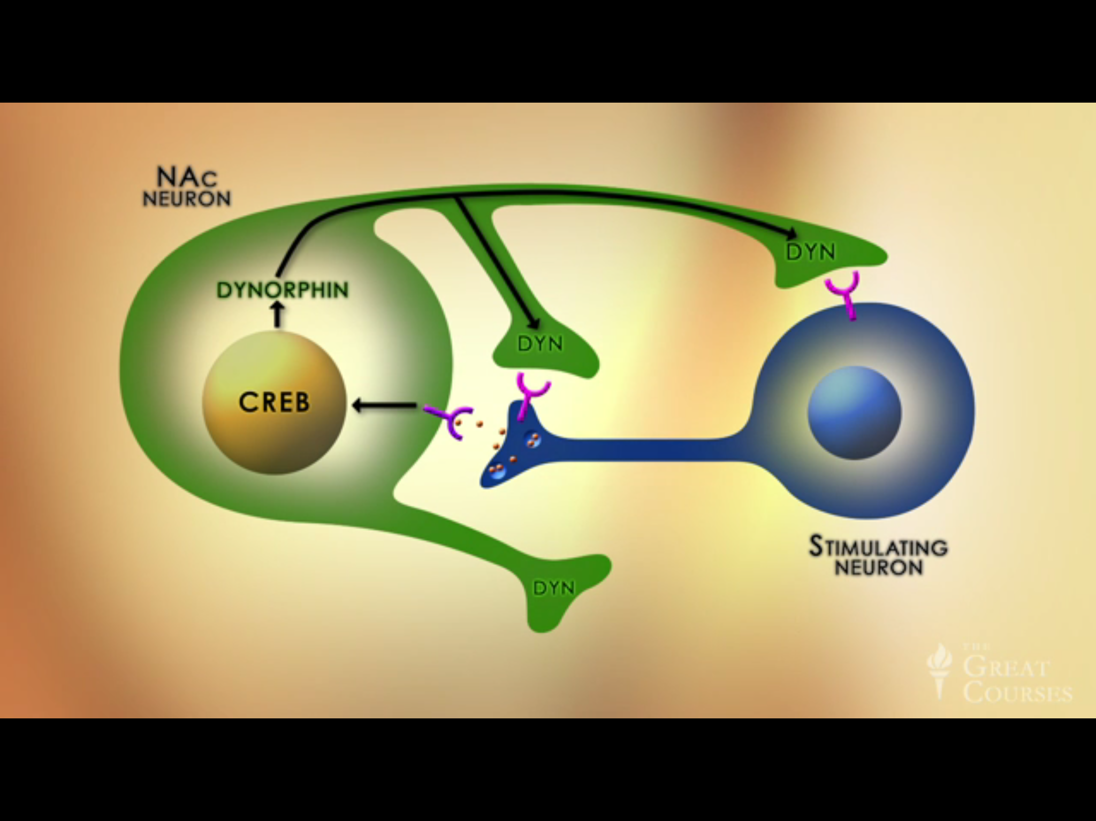

Slide 90
CREB Maintains Homeostasis in the Nucleus Accumbens

Slide 91
PreFrontal Cortex

Slide 92
Prefrontal Cortex
Can consider future consequences, and make rational decisions about what actions we should take, not what actions we feel like taking.
Site of self-control in favor of long-term goals
Chronic levels of high cortisol can damage it, as well as the hippocampus
Prefrontal lobe damage causes impaired working memory and decision making, and impaired sustained attention

Slide 93
Ventral Tegmental Area

Slide 94
Ventral Tegmental Area
Neurons fire when a reward is unexpected, and they release dopamine
Dopamine stimulates the nucleus accumbens and we feel pleasure
When dopamine is released it’s a signal that something important has happened and this leads to learning and associating the cues that are present
Parent and child are both releasing dopamine and this is important in associating human interaction with pleasure

Slide 95
Ventral Tegmental Area
Strengthens associations between the drug and environmental cues: cravings
Wanting is not the same as liking
“Wanting” is increasing as “liking” is declining
Neurons fire when a reward is unexpected, and they release dopamine to create an impulsive urge
When dopamine is released it’s a signal that something important has happened, which leads to learning associated cues
Use of the drug causes a stronger response of the dopamine system

Slide 96
Regulation of Pleasure/Motivation
Increased Dopamine
Increased CREB
Increased Dynorphin
Decreased Dopamine
Decreased Feeling

Slide 97
Summary of the Reward System
Drug stimulates the nucleus accumbens and produces a feeling of pleasure; we like it.
The unexpected reward triggers dopamine release from the ventral tegmental area and we learn associated cues.
Continued use desensitizes the nucleus accumbens through a negative feedback loop that involves CREB and pleasure is harder to produce
Continued use sensitizes the ventral tegmental area and produces more dopamine, more craving
Continued use damages the prefrontal cortex making it harder to inhibit the impulse to use the drug

Slide 99
The Polyvagal Theory
Stephen W. Porges, Ph.D.
Distinguished University Scientist
Kinsey Institute at Indiana University

Slide 100
Evolution of the Autonomic Nervous System
Earliest vertebrates defended themselves by shutting down, “disappearing”
Later, vertebrates evolved a system to mobilize: neuroendocrine; the sympathetic nervous system
Mammals developed a newer myelinated circuit that became linked to the nerves of the face, the voice and the ear muscles

Slide 101
We are the products of evolution
We repurposed all three parts of our nervous system
We have circuits for defense
We have circuits for social interactions

Slide 102
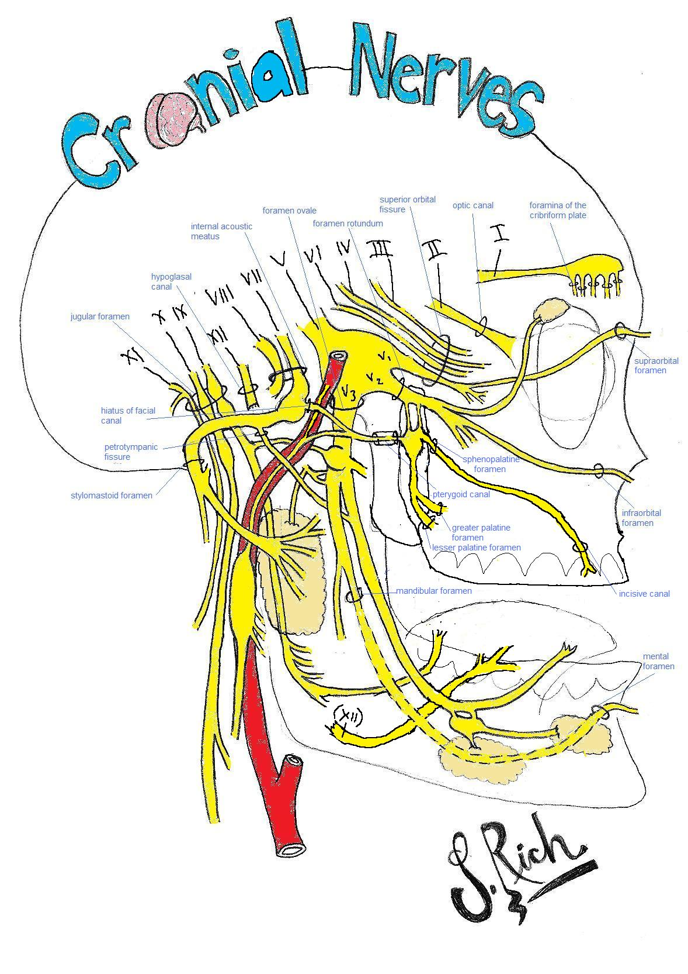

Slide 103
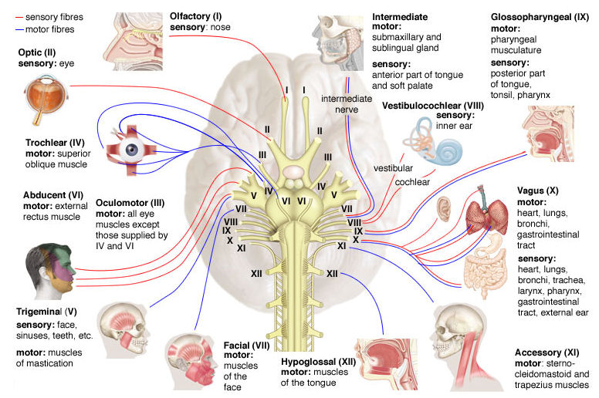

Slide 104
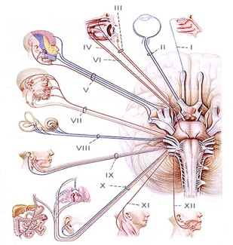

Slide 105
Face-Heart Connection
The myelinated vagus became linked to the special visceral efferent pathways:
Trigeminal (V)
Facial (VII)
Glossopharyngeal (IX)
Vagus (X)
Accessory (XI)
This forms an Integrated Social Engagement System

Slide 106
Evolutionary shifts in regulation of the heart
Originally was regulated by endocrine (chemical) communication
Later in development an unmyelinated circuit developed from the dorsal motor nucleus in the brainstem
Finally a myelinated circuit evolved from the more ventral nucleus ambiguus.
This is why yoga, meditation, breathing help to calm the body

Slide 107
Cranial Nerves

Slide 108
Why Polyvagal?
Fibers from the vagus come primarily from two different nuclei in the brainstem:
Dorsal Motor Nucleus – the older unmyelinated vagus
Nucleus Ambiguus - the newer, myelinated vagus
About 80% of vagal fibers are sensory fibers
Most of the vagal sensory projections are to the right hemisphere

Slide 110
Our brain is always assessing level of risk in the environment; outside of our awareness
Safe environments – can employ social engagement behaviors – new myelinated vagus
Dangerous environments – stop social engagement and release the sympathetic system for fight or flight – older endocrine response system (sharks, etc)
Life threatening environments – stop fight or flight and release the inhibition on the very old, unmyelinated vagus

Slide 111
Cortical control
As the cortex developed it was able to have more control over the brainstem
We have “feature detectors” that are always evaluating the environment for the level of risk or safety
Located in the temporal lobe
There is a specialized area that recognizes the human face
An experience of using your facial recognition unit:

Slide 113
You were just using the object recognition part of your brain
Now let’s switch to your facial recognition unit in your temporal lobe…

Slide 115
“Prosopagnosia”

Slide 116
Phylogenetic organization of the autonomic nervous system
The three circuits developed through evolution
The newest mammalian circuit – myelinated Vagus (social engagement)
The older bony fish circuit – sympathetic system (fight or flight)
The oldest reptilian circuit – unmyelinated Vagus (disappear)

Slide 117
Behaviors emerge out of our physiological state….
Social communication: facial expression, vocalization, listening
Mobilization: fight or flight behaviors
Immobilization: shut down, disappearing, feigning death
…depending on our unconscious assessment of the environment

Slide 118
When we assess a safe environment our ventral, myelinated Vagus is active
This is a myelinated circuit that developed in mammals
Innervates the muscles of the face, middle ear muscles, larynx, pharynx
Allows for social engagement
Allows us to hear human speech
Gives our voice prosody
Inhibits the older defensive circuits

Slide 119
When we assess a dangerous environment our sympathetic system is active
The ventral myelinated Vagus shuts down
Heart rate increases
Blood flow is to the muscles and away from viscera
Social engagement system is not working
We are ready to run or fight
Face is flat

Slide 120
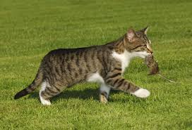
When we assess the environment as life-threatening our older dorsal unmyelinated Vagus is released
Unmyelinated dorsal vagus
Oldest defensive circuit
Slows heart rate and breathing
Lowers blood pressure
Raises pain threshold
Dissociative
The brain figures its best option is to freeze and disappear

Slide 121
Overview
Temporal cortex uses feature detectors to assess level of risk
If safe we use our social engagement system through the ventral vagus
This is an emergent behavior, not a learned behavior

Slide 122
Overview (cont.)
If dangerous the ventral Vagus turns off and the sympathetic system turns on
This prepares our body to mobilize
If life threatening the sympathetic system turns off and releases the unmyelinated Vagus
We immobilize and disappear by lowering heart rate, blood pressure

Slide 124
What determines what is safe, dangerous or life threatening?
What our experiences have been up to that point!
Early childhood experiences have the biggest impact.

Slide 125
The most effective way to enhance effective social behavior is to create safe environments
Let the myelinated Vagus inhibit the defensive behaviors

Slide 126
Play behavior
We can have mobilization without fear: it is called play behavior
In play we are using our social engagement system (ventral vagal) as well as our sympathetic system
An important aspect of the parent-child relationship for brain development

Slide 130
Private behaviors
We can have immobilization without fear
When we sleep, eat, defecate, nurse, have sex
We do these things in safe environments, rooms
Immobilization without fear is pleasurable; but immobilization with fear is terrifying

Slide 132
Past experience determines Present Behavior
Behavior emerges out of a physiological state
That physiological state is determined by our unconscious assessment of the level of risk
Our assessment of risk is determined by our past experiences, especially in childhood
Defensive behavior is not intentional
Our physiological state drives choices, and determines our health

Slide 133
The external environment may be the same for everyone, but….
The internal environment is different for everyone
The external environment is processed and experienced differently by each individual brain

Slide 134
How do we help people regulate their behavior?
Need to create safe environments
In safe environments the ventral vagus can express itself
We can use our social engagement system to turn off defensive systems
Social engagement behavior is not a learned behavior; it is an emergent behavior out of a physiological state

Slide 135
It’s important to get a sense of what the person’s early environment was like
Understand the way their brain learned to interact with the environment
The first step is to create a safe environment
How to do that will differ with each individual
Defensive behavior can be suppressed by the newer ventral vagal physiology
Allows social behavior to emerge

Slide 136
Important take-home points
Behavior is adaptive, “bad habits” can be coping strategies to manage a dysregulated system
Behavior emerges out of our physiological state
Physiological state is dependent on assessment of risk by our feature detectors
What we assess as dangerous or life-threatening is based on past experience
These behaviors have a large impact on our overall health and ability to function

Slide 137
“The truth about childhood is stored up in our bodies and lives in the depths of our souls. Our intellect can be deceived, our feelings can be numbed and manipulated, our perceptions shamed and confused, our bodies tricked with medication, but our soul never forgets. And because we are one, one whole soul in one body, someday our body will present its bill.”
Alice Miller

Slide 138
Thank you

